Slide 1
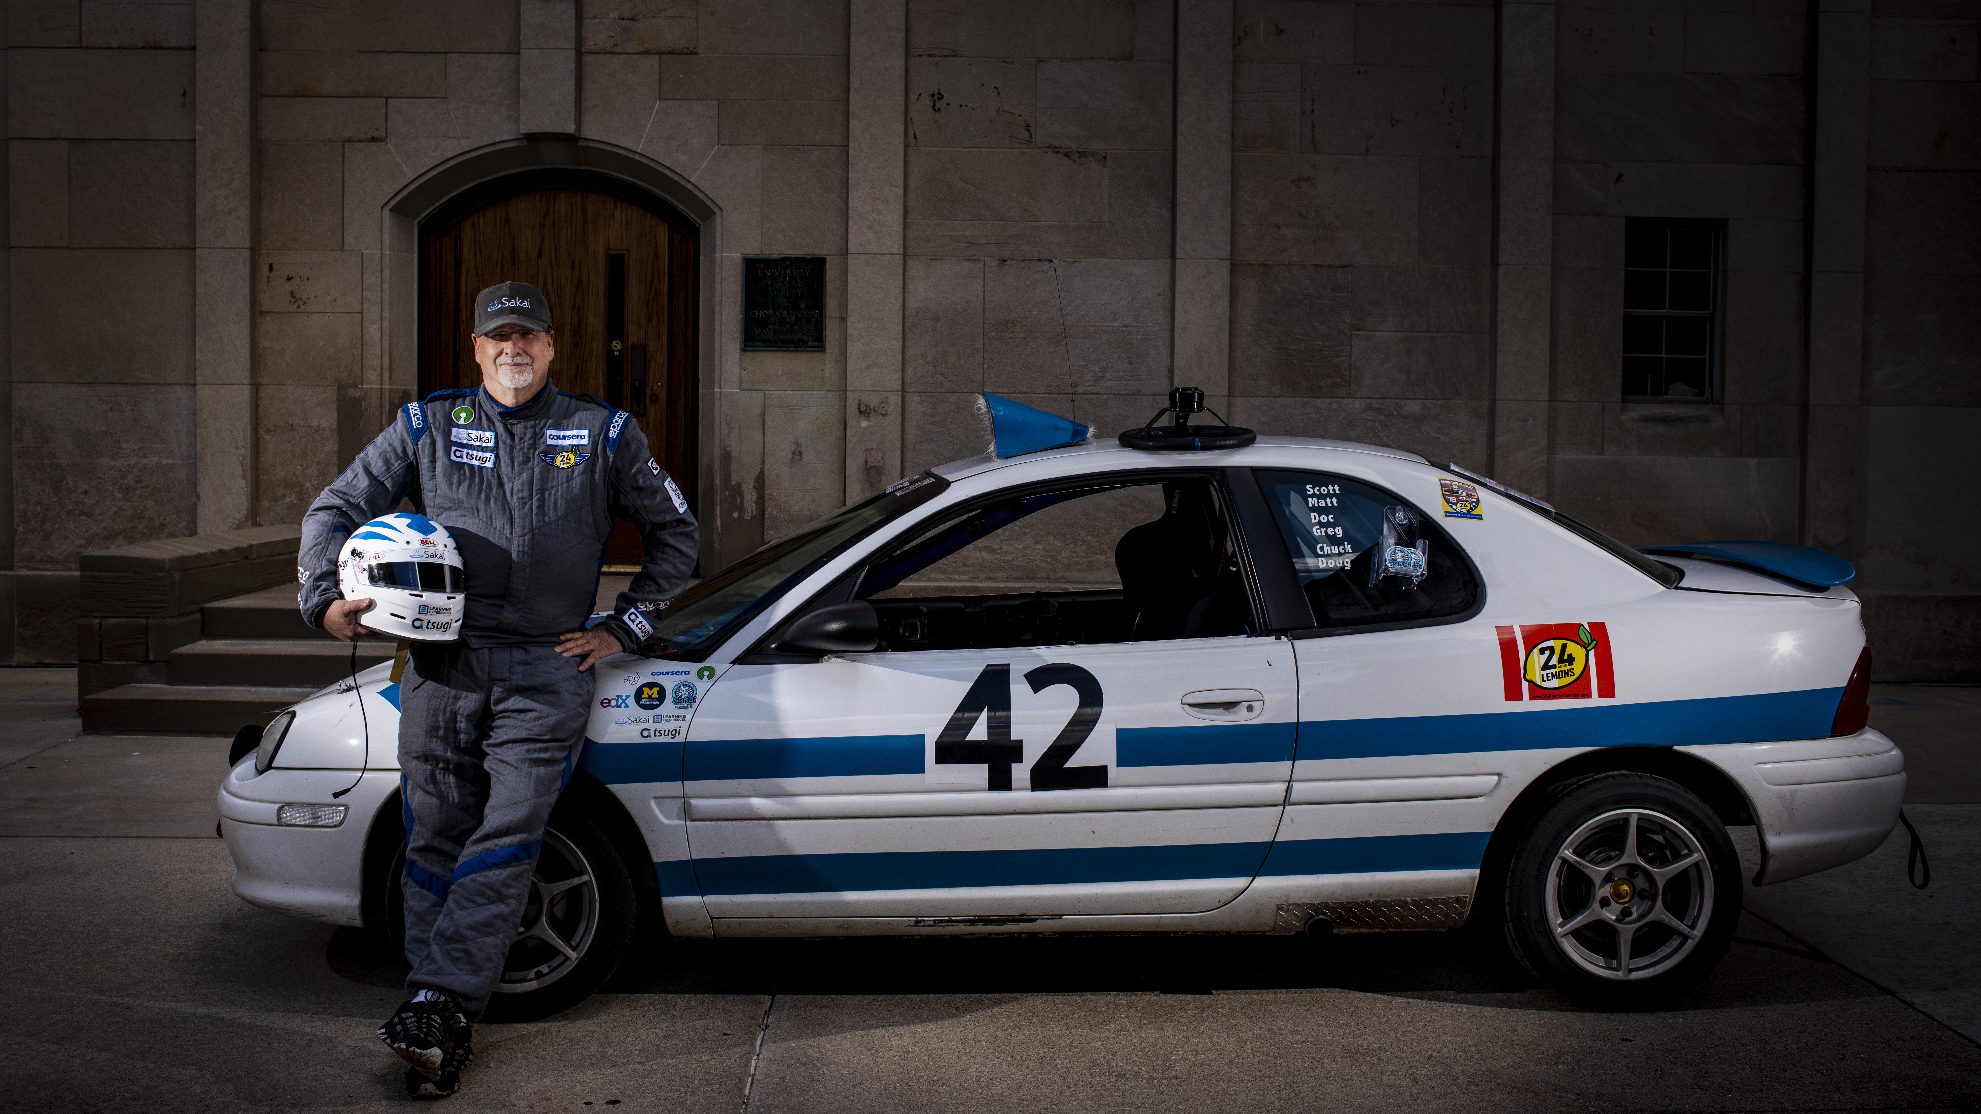
Django for Everybody
Charles R. Severance
www.dj4e.com
Photo: Jeffrey Smith

